Slide 1
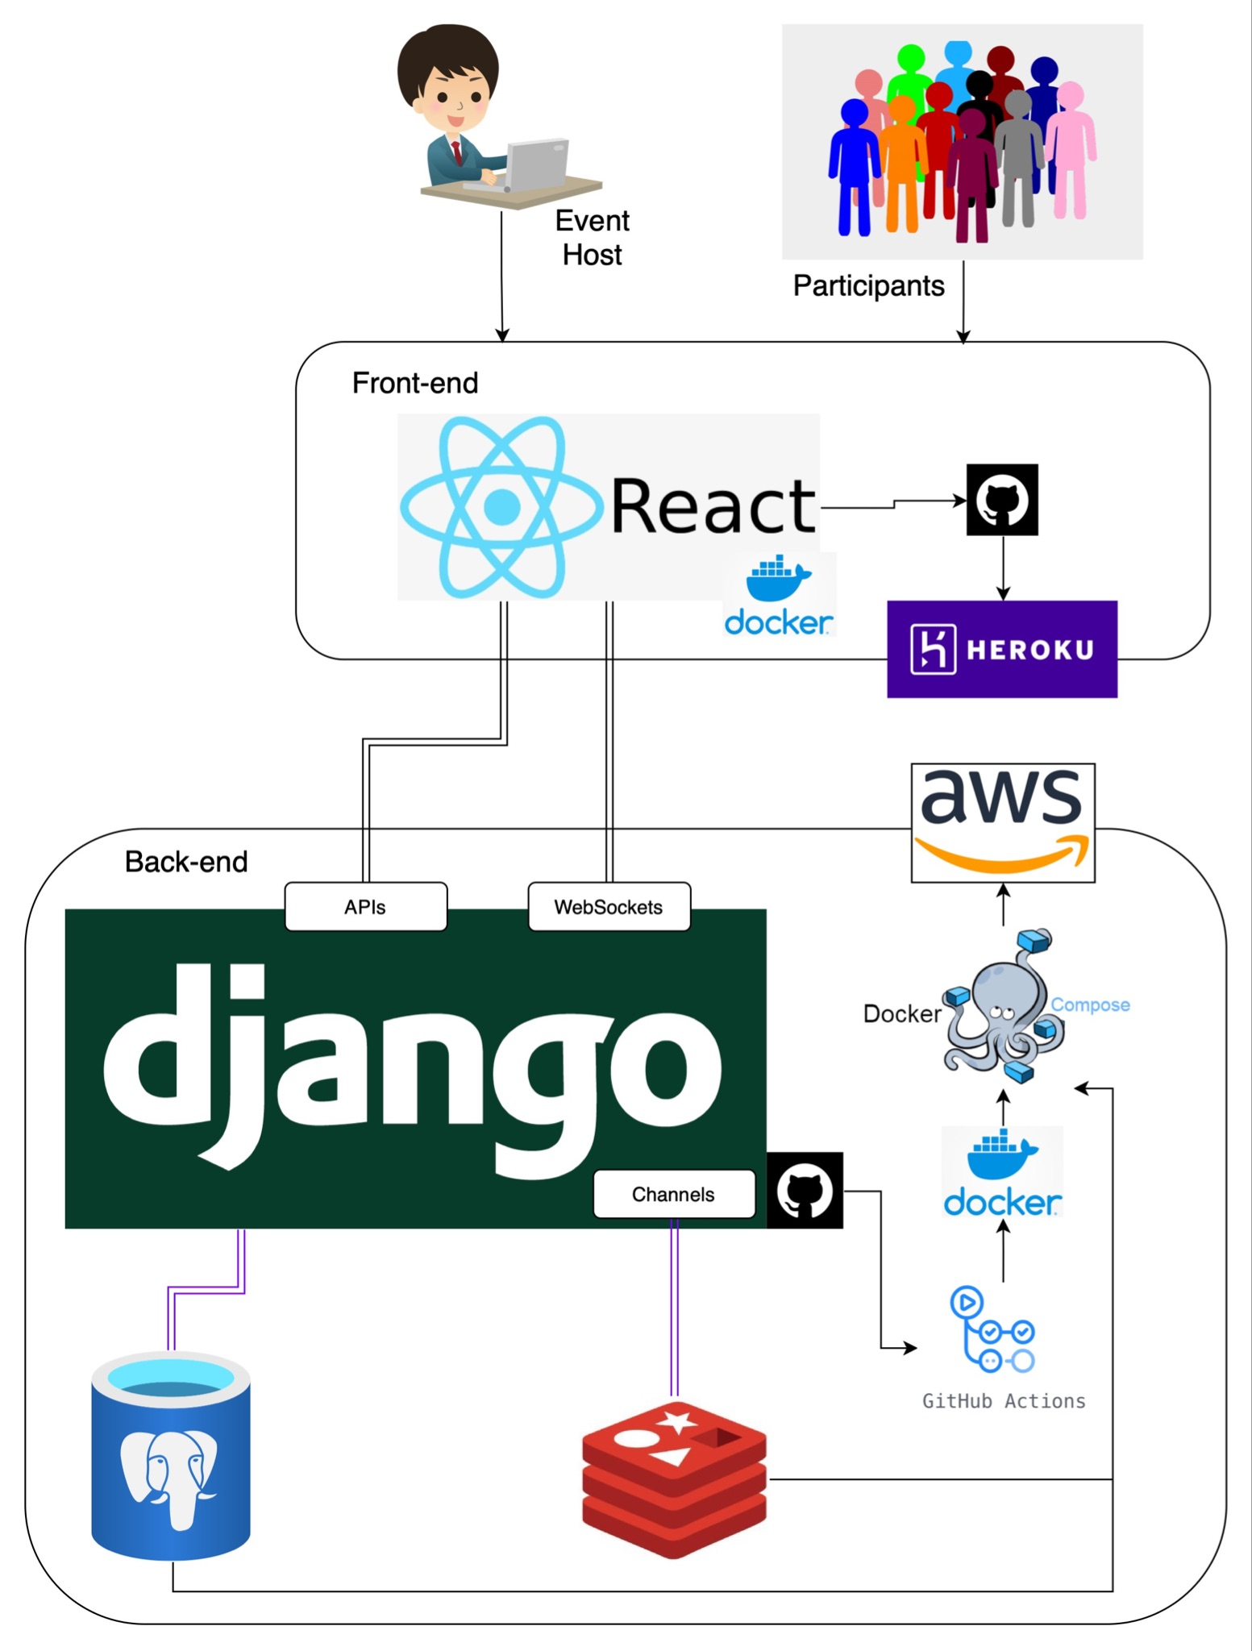
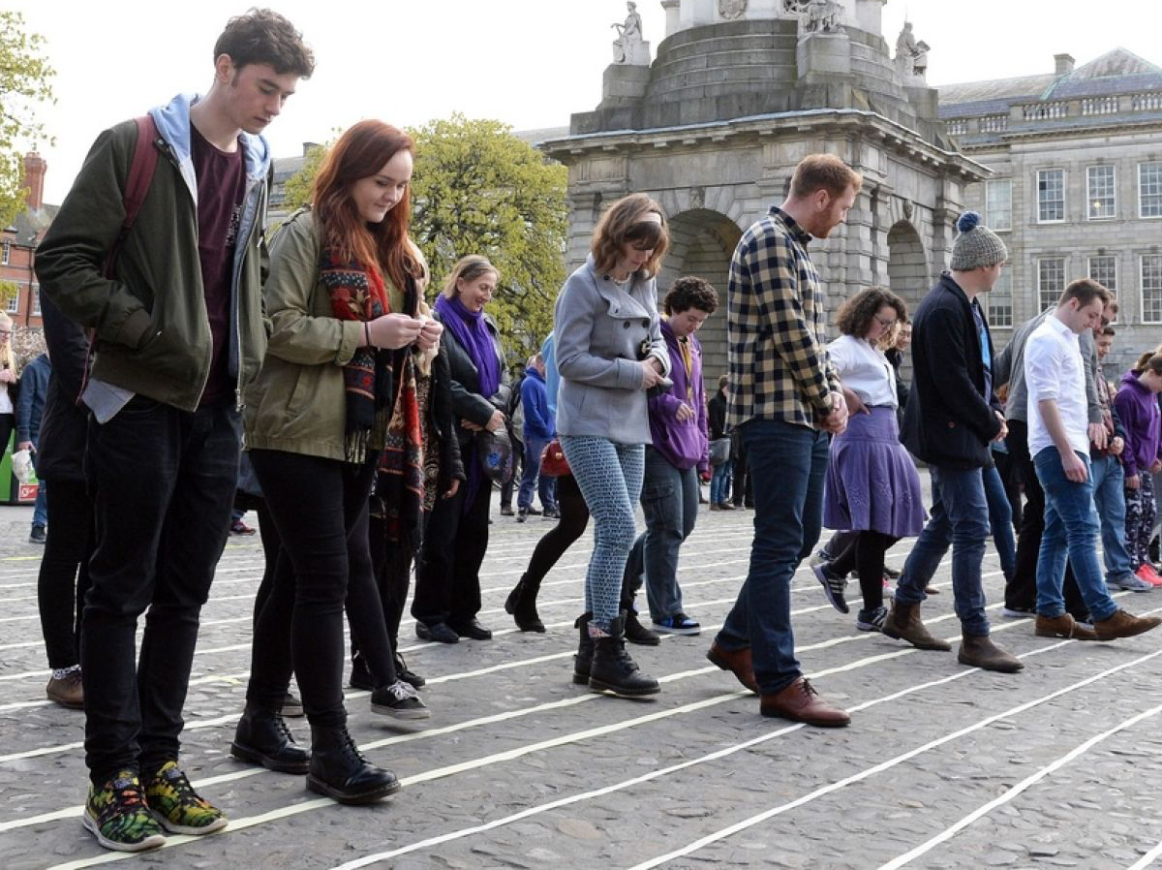
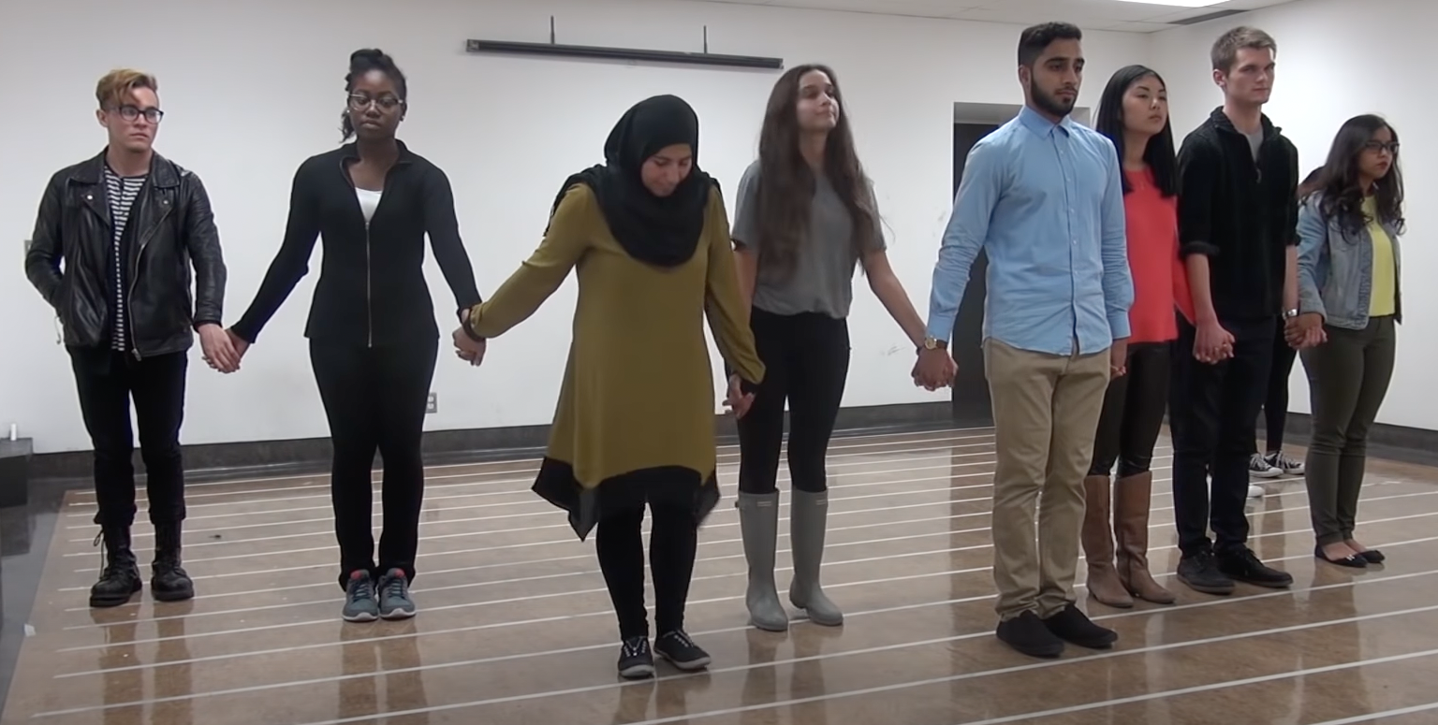
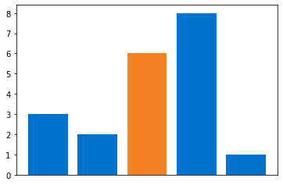
Perspective Walk
TECH
STACK
USE CASES:
• Company induction
(or team building)
• College Orientations
• Classroom activities
• Ice breaking events
CHALLENGES
• Tight deadlines
• Estimating tasks and handling edge cases
• Vague requirement specifications
• Changes or modifications in requirements
• Last-Minute Defects and Escalated Issues
LEARNINGS
• Breaking down tasks into smaller chunks
• Starting small and then extending it to other edge cases
• Confirming assumptions with clients
• Importance of documentation
• Automated tests
• Test every piece of code
• Change one thing at a time with Pull Requests
Line standings:
PROBLEM:
• Perspective Walk is a live activity where participants standing in a line, respond to the host’s questions individually, either by moving forward or backward
• The final positions of the participants reveal about the diversity in the group
• However, sometimes participants feel nervous or shy in honestly responding to a question being conscious about the other participants and/or the host
SOLUTION:
• The activity will be conducted online through a web app instead
• The participants are anonymous to each other, as well as to the host
• Participants with the event link can join the activity from anywhere (on-site or remotely) anonymously
• At the end of the activity, participants can see their results/position in the form of graphs/charts

